Slide 1
Web Development
Module 2, Lesson 9:
Serverless Computing with Azure Functions

Slide 2
Topics
Serverless Computing
Azure Functions

Slide 3
Objectives
By the end of this lesson you should be able to:
Understand Serverless Computing, how and when to use it
Understand Azure Functions
Interact with Azure Functions

Slide 4
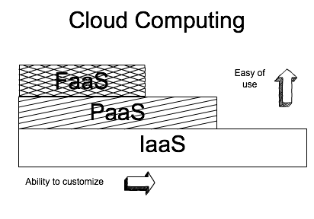
Benefits of Serverless and Cloud Computing
Easier to operate and manage apps
Faster innovation and scaling
Great community
Notes:
Notes:
Simply, FaaS is built on PaaS and PaaS on IaaS. Talk about PaaS and IaaS (from previous lessons).
References:
https://www.infoq.com/news/2016/12/Azure-Functions-GA

Slide 5
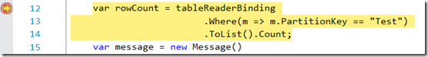
What is Serverless?
Serverless is event driven logic (functions) in the cloud
Notes:
References:
https://blogs.msdn.microsoft.com/webdev/2016/12/01/visual-studio-tools-for-azure-functions/
Going Serverless
http://thenewstack.io/amazon-debuts-flourish-runtime-application-model-serverless-computing/
Amazon Debuts Flourish, a Runtime Application Model for Serverless Computing

Slide 6
Serverless Computing
Still has servers but they are abstracted (hidden) from developers/end users like us.
Drive-through model: "You pay for the hamburger, not the cow". (Tofu not soy field for vegetarians.)
Notes:
References:
Tim Wagner (GM at AWS Serverless which includes AWS Lambda) at ServerlessCon

Slide 7
Serverless Use Cases
IoT
Rarely/infrequently used processes (cut costs)
Analytics, big data
Microservices
Batch jobs, e.g., image or video processing

Slide 8
Use Cases: Surveys and Archiving
Surveys
Archiving
Web page form hosted on a static web server
DocumentDB or Azure Table storage to store data
Azure Function to respond to POST /survey (stateless) by saving the data to DB
Cloud storage for file uploads (CSV)
Event listener to trigger Azure Function
Azure Function to compress (gzip) CSV into zip archive
Notes:
Notes:
Webpack can be stored on the static web server, data is submitted to the Azure Function endpoint and saved in the database

Slide 9
Use Cases: Bots and Firewalls
Bot
Firewall
Bot which sends a message
Bot Framework to trigger Azure Function
Azure Function which calls Cortana Analytics service to answer a message
CloudFlare API to block IPs
Azure Function to store IPs to block in Azure table
Azure Function on time to remove blocked IPs after 1h
Notes:
References:
https://www.troyhunt.com/azure-functions-in-practice/

Slide 10
Azure Functions
You can run it on your own infrastructure
Serverless environment from Microsoft Azure cloud computing family of services
Azure Functions UX is Open Source
No vendor lock in
Transparency of up-coming features and existing bugs
Notes:
Notes:
But most likely, you would need other Azure services.
References:
https://github.com/projectkudu/AzureFunctionsPortal

Slide 11
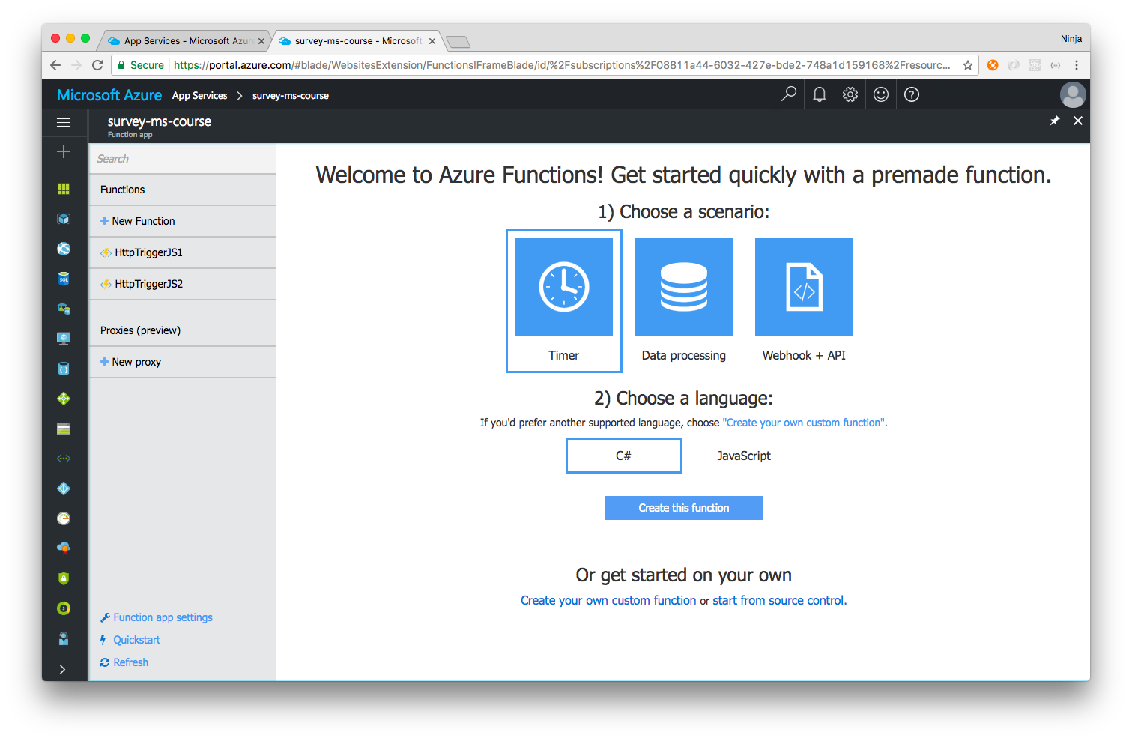
Azure Functions Portal
Types
Web API
WebHook
Code triggered by event
Code triggered by time
Languages
JavaScript
C#
F#
Python
PHP
Bash
Batch
PowerShell
Notes:
Notes:
Azure Functions Portal allows developers to create and manages functions as well as integrate them with other Azure services (Azure Bot Service, App Service, Automation)
Azure Functions Endpoint
WebHook + API functions have an HTTP(S) endpoint:
There are 3 main types: WebHook+ API, Time and Data Process.
References:
https://functions.azure.com

Slide 12
Azure Functions Template Format
Templates are pre-defined functions that demonstrate a working scenario and could be used as a starting point for more complex ones
Binding.json
Function.json
Code file
Metadata.json
Sample.dat
Notes:
Notes:
Binding.json
This is a metadata file for all the bindings and their possible configuration settings. It is common across all templates and is located here. It also contains metadata for binding related UI Elements and the corresponding text.
Function.json
This file contains binding data specific to each template. It provides valid values for the possible settings on a binding.
Code file
Code file holds the actual code executed by the template. The name of the file depends on the Target language used by the template. For all the languages, the file name is run, followed by the file extension specific to the language. Additionally JavaScript also supports index.js as the name of the code file.
Metadata.json
UI related metadata specific to each template is present here. For e.g. Template Name, category.
Sample.dat
Sample.dat contains sample input data for each template. The Run text box in the portal will be populated by the contents of the sample.dat file.

Slide 13
Azure Functions Endpoint
WebHook + API functions have an HTTP(S) endpoint
3 Main Types of Endpoints
WebHook + API
Timer
Data Processing
Notes:
There are 3 main types: WebHook+ API, Time and Data Process (previous slide).

Slide 14
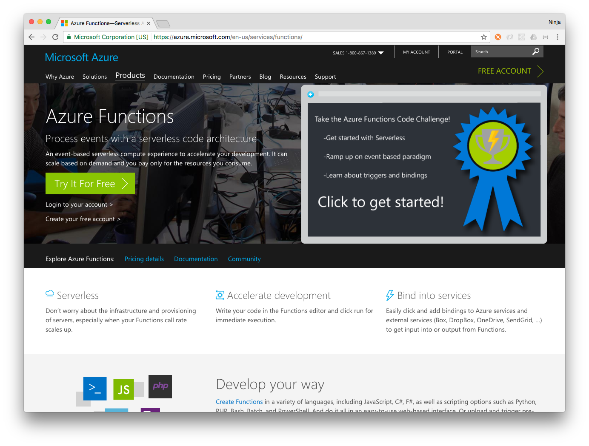
Creating a Function
The following 3 slides walk through using Azure Functions to set up a serverless solution
Notes:
Notes:
Log in to Azure Portal (https://portal.azure.com/)

Slide 15
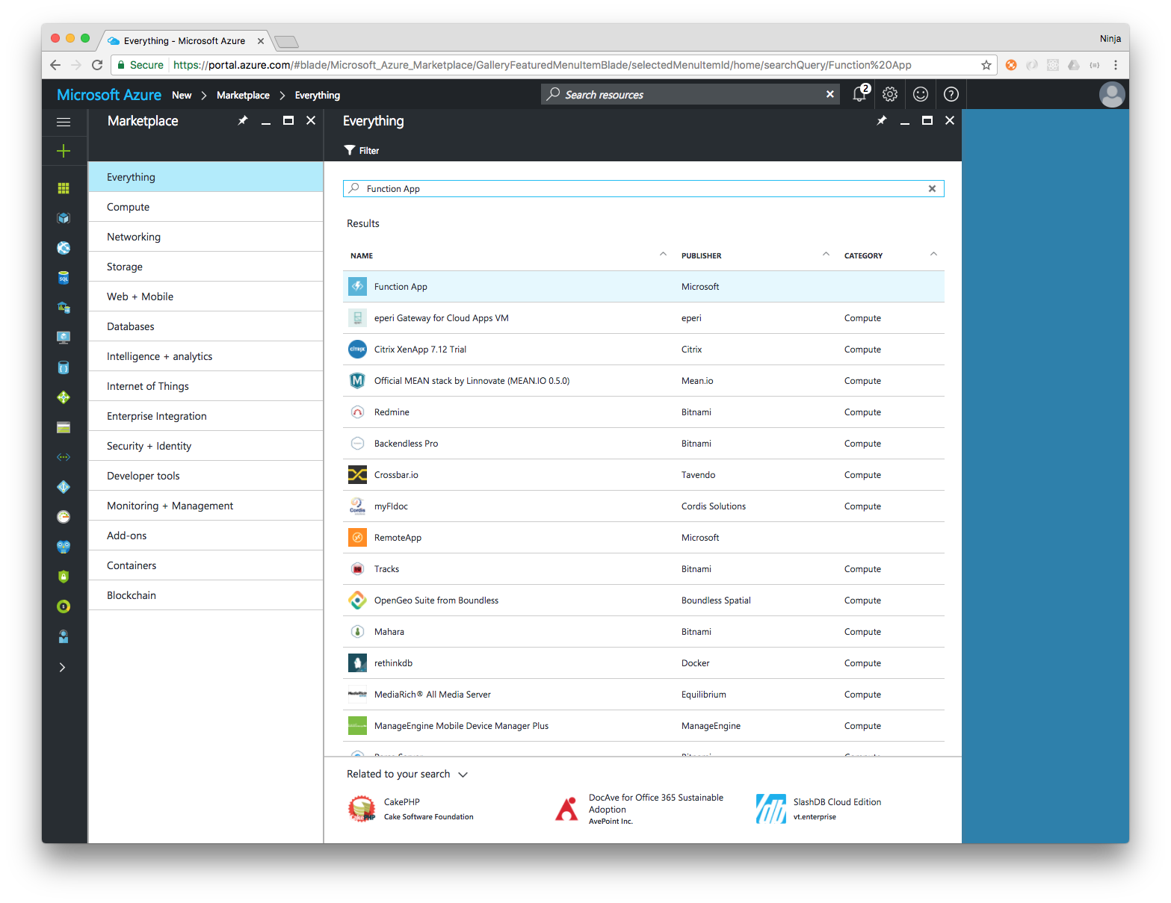
Create a new Function App
Notes:
Notes:
Select "New" (plus in the left sidebar), then type function app and press enter. Select "Function App" from the search results and press "Create" on the right pane (Functions App detailed view).

Slide 16
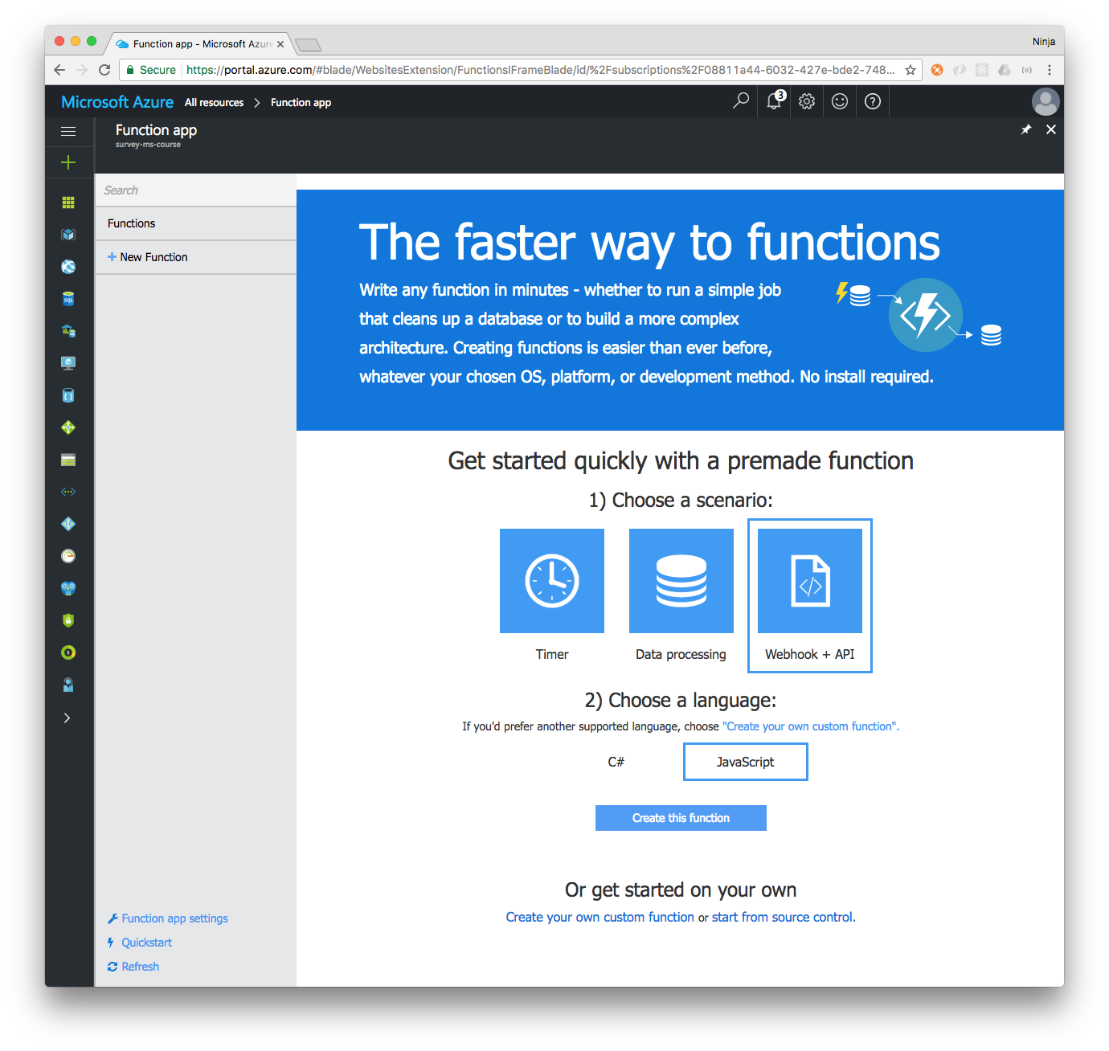
Determine the Function Type
Notes:
Notes:
Select: WebHook+API and JavaScript for a web app endpoint. Other options: Timer (triggered on time) and Data Processing (for batch processes). Select JavaScript. (Note: Other languages are possible too.)

Slide 17
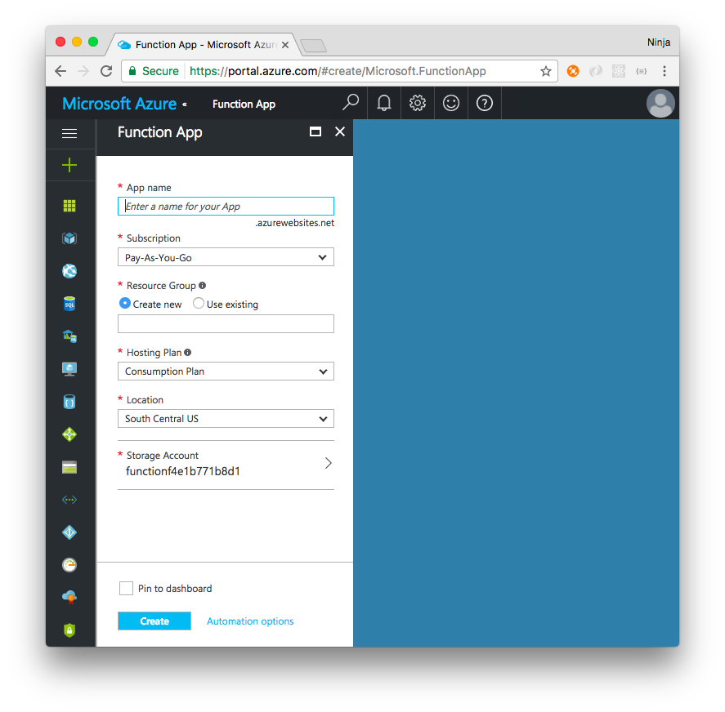
Naming and Creating
Name | Value
App name | ms-course-test-123
Subscription | Pay-As-You-Go
Resource Group | default (Use existing)
Hosting Plan | Consumption Plan
Location | South Central US
Storage Account | functionf4e1b771b8d1
Notes:
Notes:
Enter required info: name (must be unique), subscription (Pay-As-You-Go), resource group (you can choose existing), hosting (consumption plan), location (South Central US) and storage account (by selecting storage, you can select existing account or create new).
CONGRATS!! You have just created your first Function App!

Slide 18
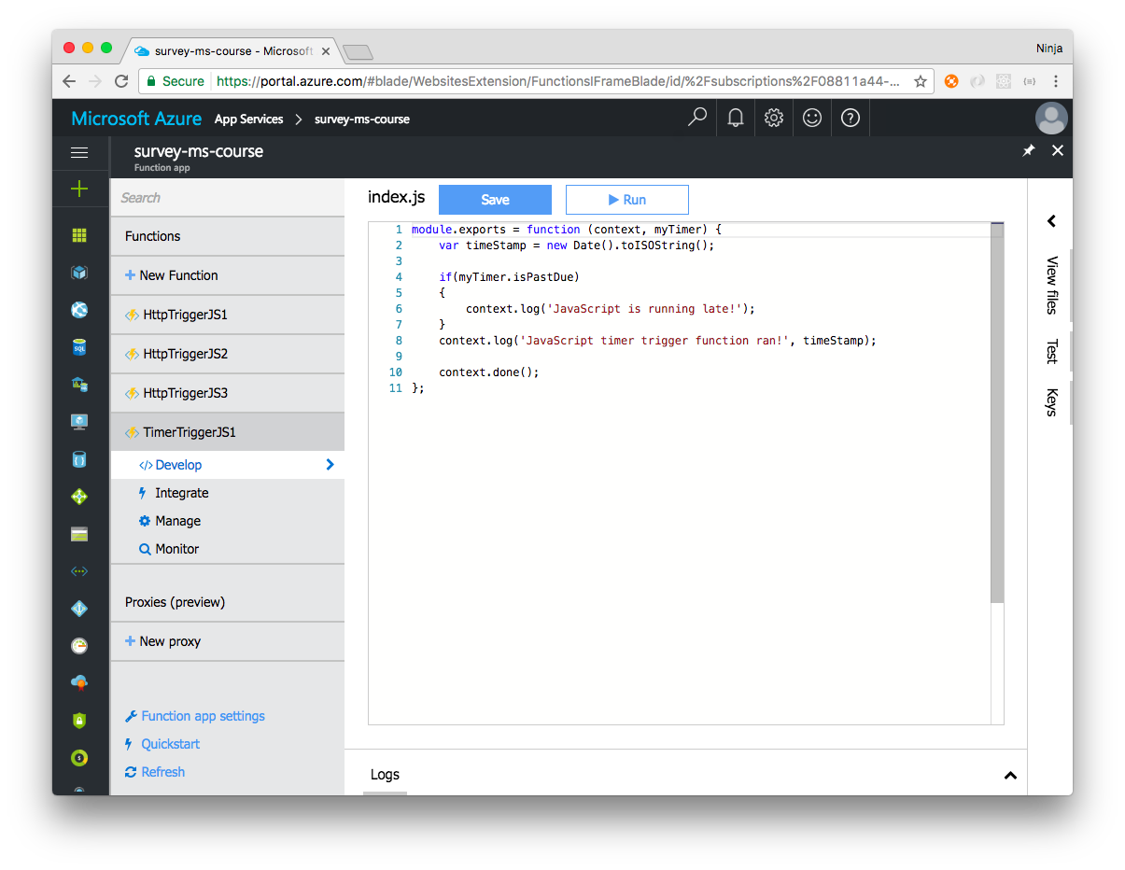
Multiple Functions of a Functions App
Functions:
HttpTriggerJS1
HttpTriggerJS2
HttpTriggerJS3
TimerTriggerJS1
Notes:
Notes:
This functions app has multiple function: http and time triggered.
If you selected WebHook+API, then your first function in your newly created app will be HttpTriggerJS1.

Slide 19
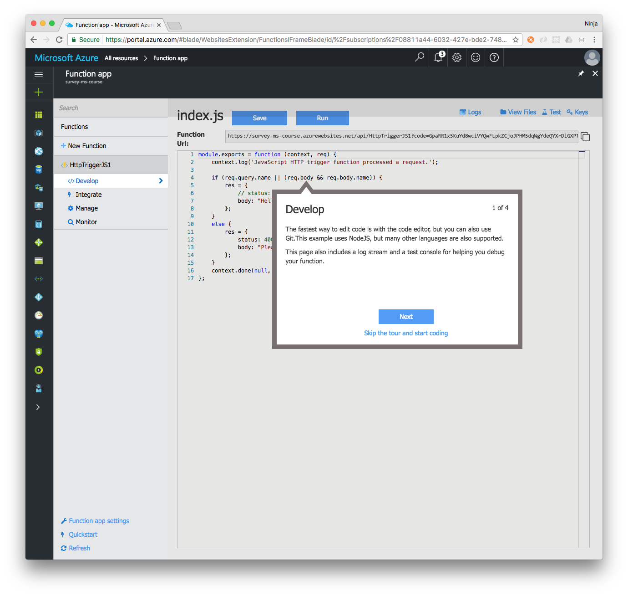
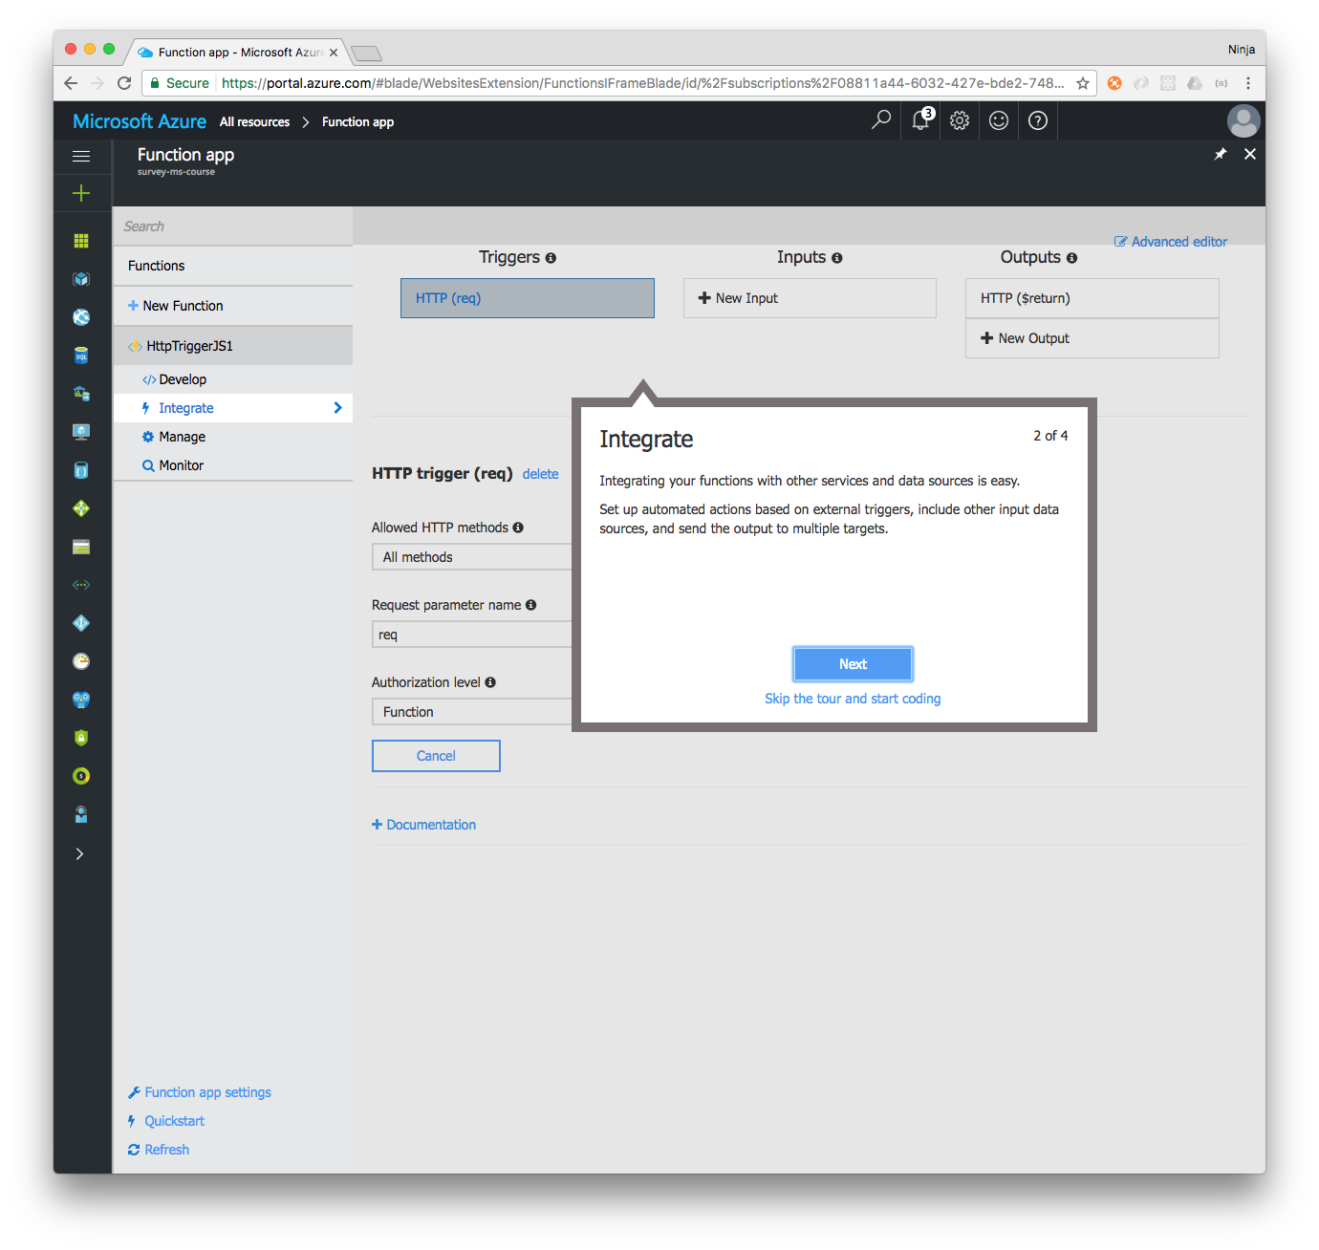
Working with a Function
Notes:
Notes:
- Next 4 slides to work with a function
Develop: This is where you write the code
Integrate: add/remove/manage other in and out services

Slide 20
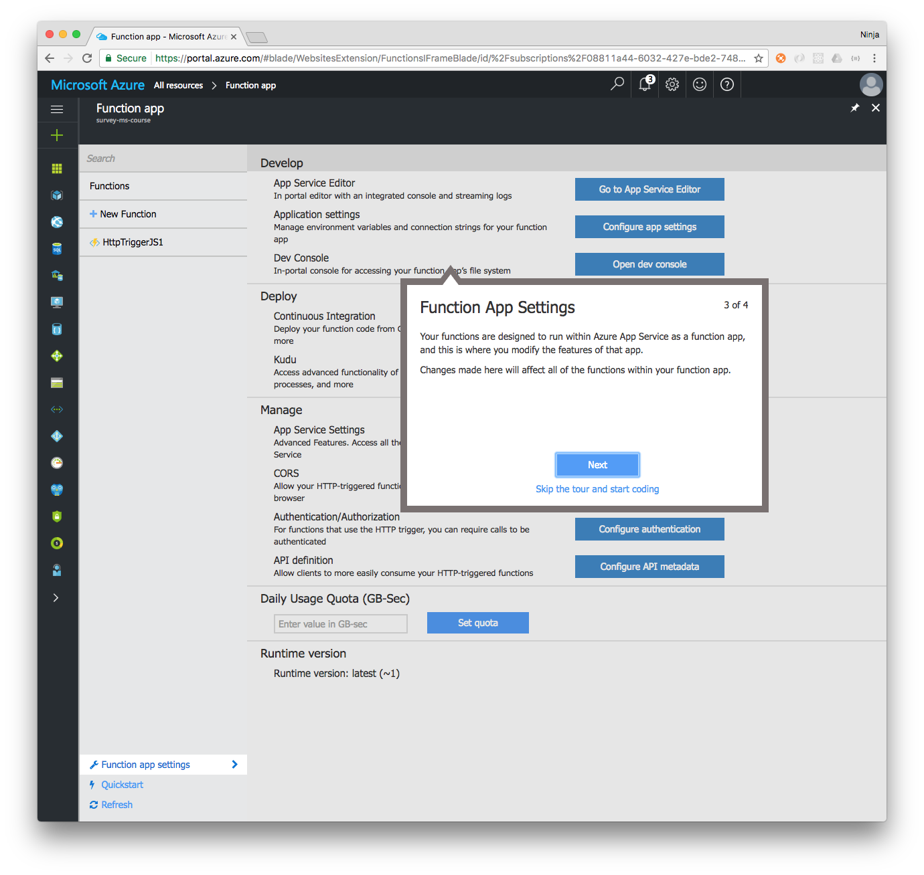
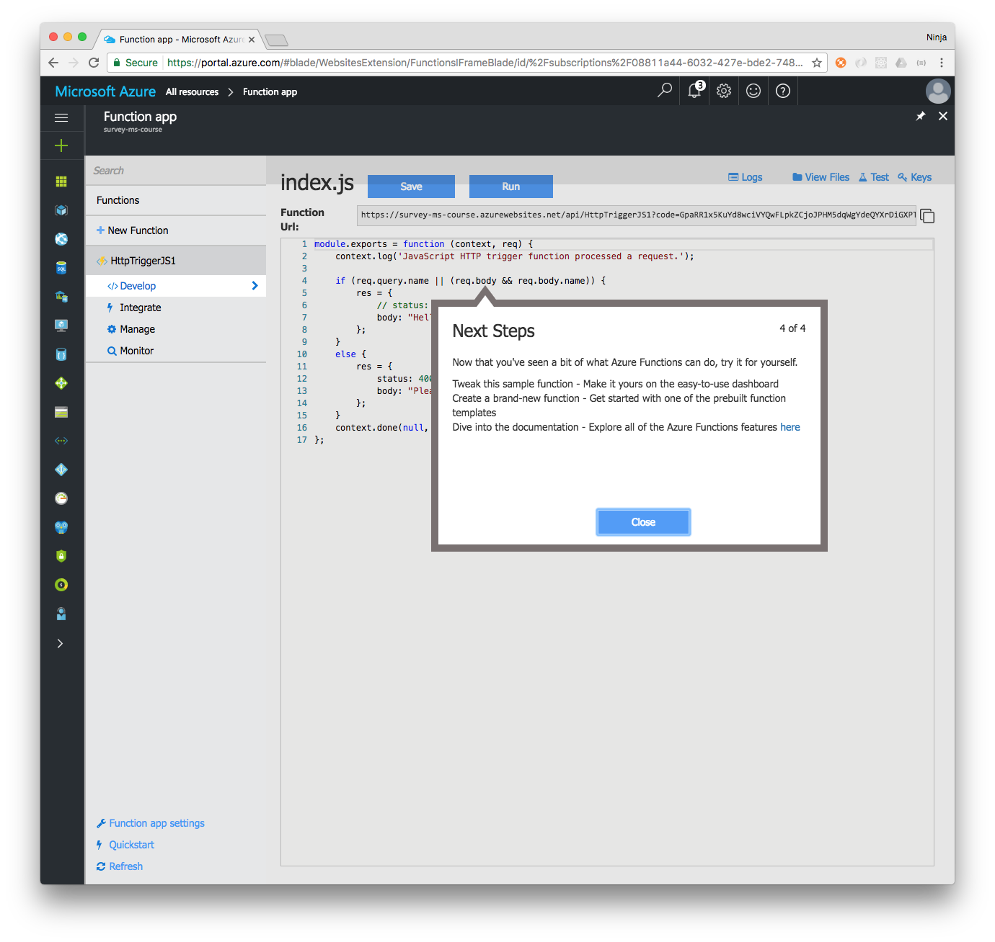
Function Application Settings
Notes:
Notes:
Function App Settings: set environment, versions, environment variables, CORS and other settings
Develop: write custom code for your function. For example, save payload from the survey form into the database

Slide 21
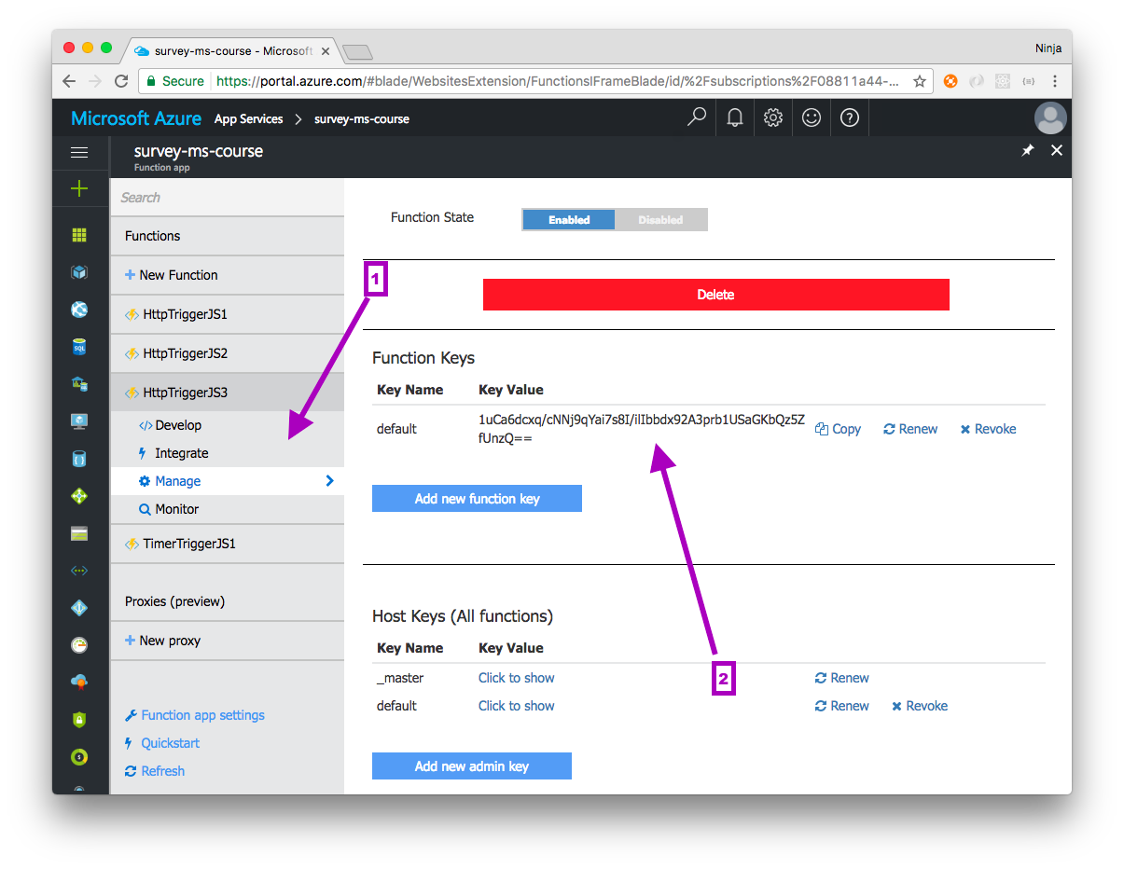
Managing Keys
Notes:
Notes:
The function key(s) is in the "Manage" pane: Manage | Click to show | Copy
Select "Manage" from the left menu for the function, and then select "Click to show" and then "Copy"
To See Your Web Functions Live, Go to URL:
https://{func-app-name}.azurewebsites.net/api/{func-name}?code={function-key}
For example, for survey-ms-course:
https://survey-ms-course.azurewebsites.net/api/HttpTriggerJS3?code=1uCa6dcxq/cNNj9qYai7s8I/ilIbbdx92A3prb1USaGKbQz5ZfUnzQ==

Slide 22
Integrate
Azure Functions can have triggers, inputs and outputs called bindings
Triggers | Inputs | Outputs
Time (Schedule) HTTP (REST request or a WebHook) Events | Azure Blob Storage External File or Table Azure Table Storage Azure Document Storage Azure Mobile Table Record Bot Framework | Azure Event Hub Azure Table Storage Twilio SendGrid
Notes:
Notes:
Bindings represent the necessary meta data used to connect your code to the desired trigger or associated input or output data. The function.json file for each function contains all related bindings.
Triggers are event responses used to trigger your custom code. They allow you to respond to events across the Azure platform or on premise.
Describe each Input
Output to Azure or external services

Slide 23
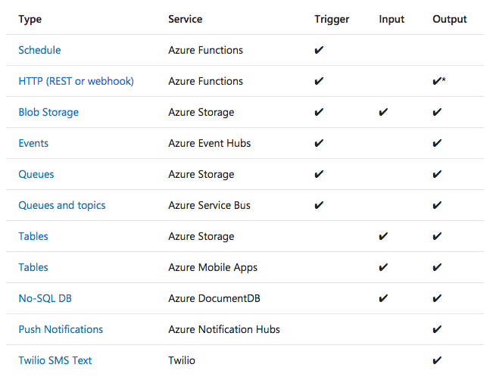
Bindings
* = The HTTP output binding requires an HTTP trigger.
Notes:
Notes:
There is no limit to the number of input and output bindings a function can have. However, only a single trigger binding is supported for each function. https://docs.microsoft.com/en-us/azure/azure-functions/functions-bindings-storage-table

Slide 24
Code Along: Serverless Survey
The following slides are a guide through the set up of a serverless survey using Azure Functions, including the following steps:
Create Azure Storage
Create a survey HTTP function which saves data from an HTML page to Azure Table
Create HTTP function to serve the HTML page (Optional)
Notes:
Notes:
Imagine, you work for a hotel chain and your task is to implement a new survey (HTML page) and host it while other providing the back-end code to save the survey data into the database (for future use). Form will be use infrequently, and it's a standalone page (functionality) so serverless is a great choice!

Slide 25
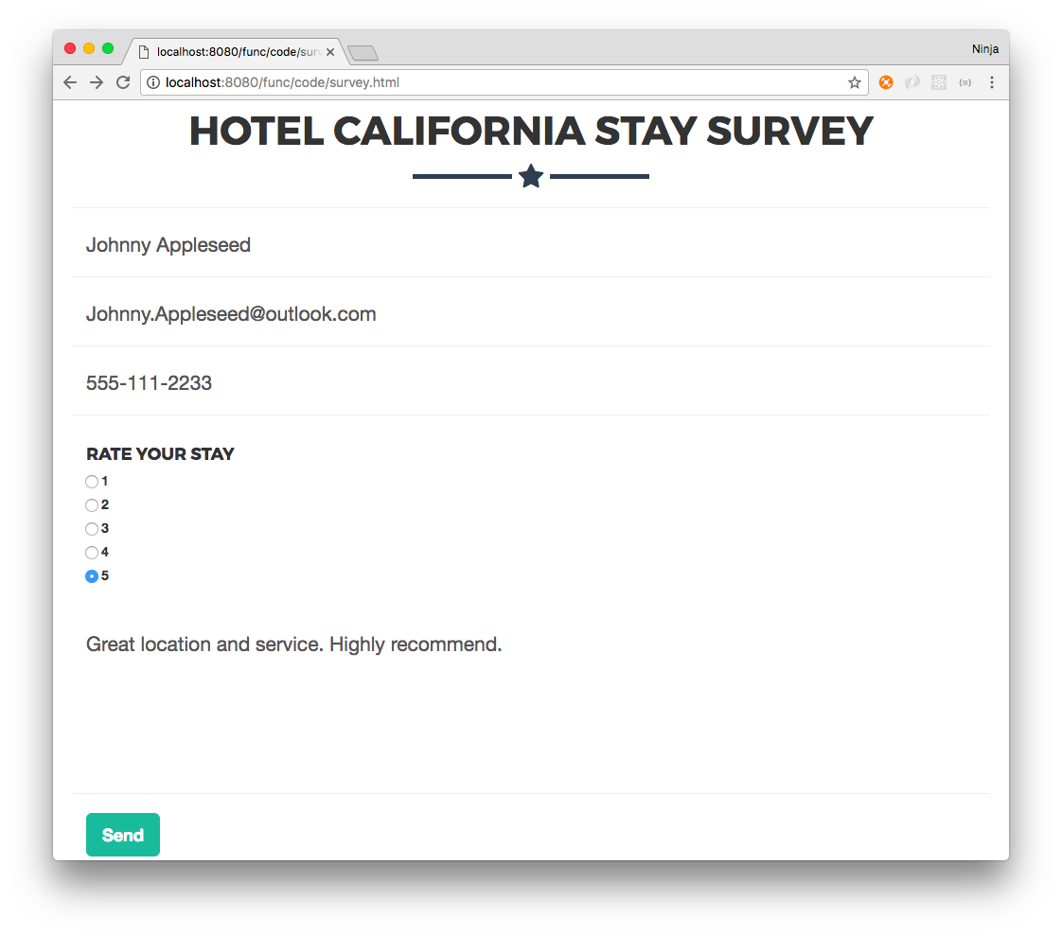
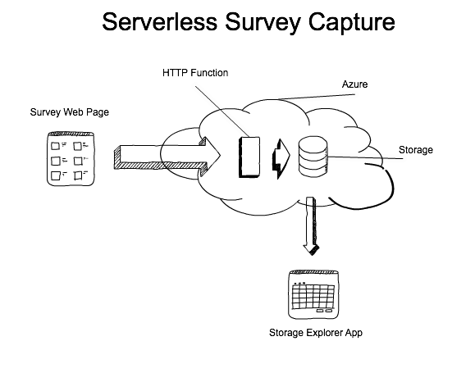
Serverless Survey: Goals

Slide 26
Serverless Survey: Create a Function
Use the function created earlier in this lesson, or create a new one
Notes:
Notes:
Use steps in this lesson to create a new HTTP function in JavaScript or use your existing HttpTriggerJS1 function

Slide 27
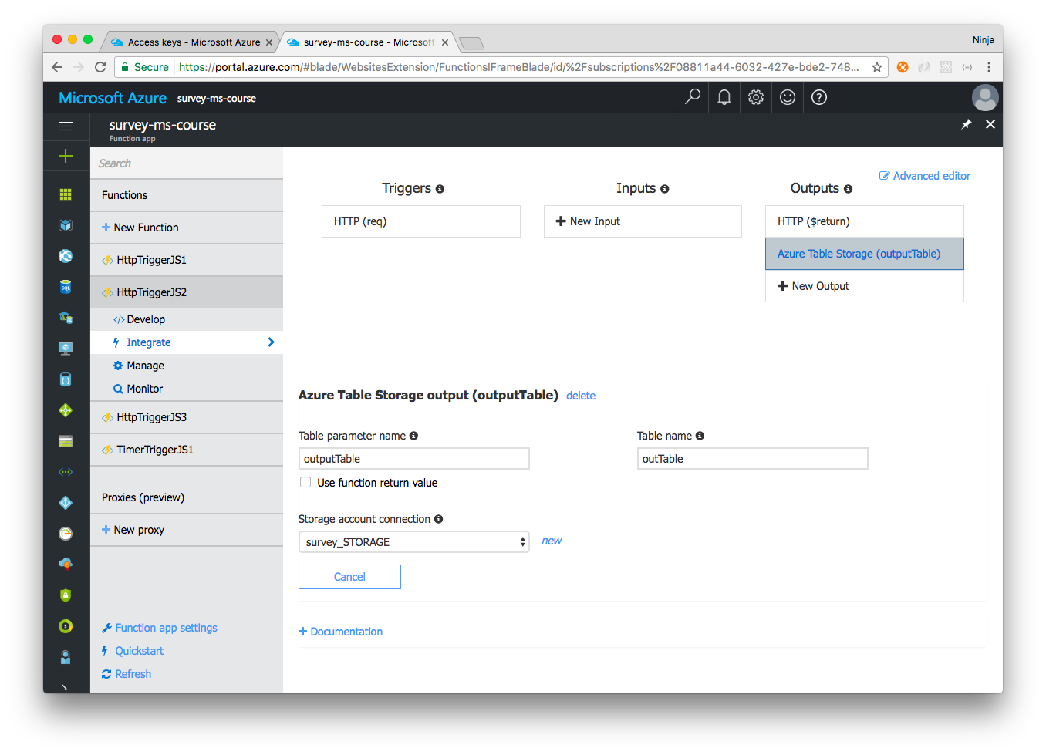
Serverless Survey: Outputs
Select Integrate | Outputs | Azure Table Storage
Select new in "Storage account connection”
Notes:
Notes:
Let's configure the output. Review previous lessons for Azure Storage (contains Table and other types).
Select existing (or create a new) Storage account. Environment variable will be added automatically. Of course, it's possible to copy storage account name and key into app settings and use the environment variable, but this way is faster.

Slide 28
Storage Account
Select existing (or create new) Storage account
Environment variable will be added automatically

Slide 29
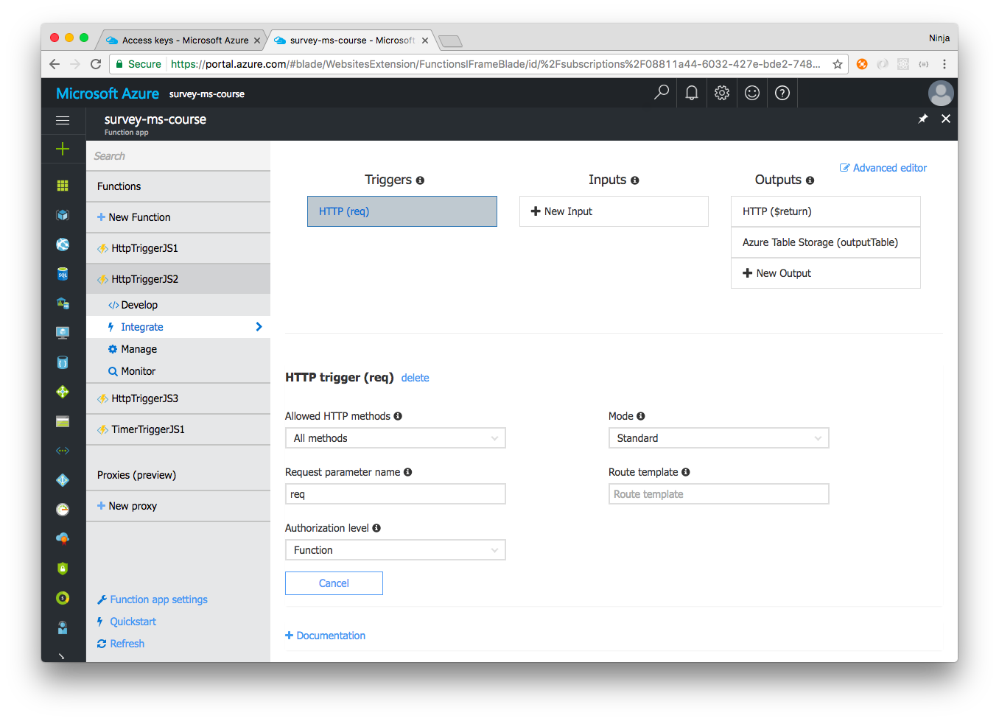
Serverless Survey: Check HTTP trigger
Verify Settings
Notes:
Notes:
The settings must look like the ones on the screenshot.

Slide 30
Develop: index.js
Select Develop and type this code. This code declares a request handler for the HTTP function.
module.exports = function (context, req) {
const error = (err)=> {
let res = {
status: 400,
body: err
}
context.done(null, res)
}
context.log('JavaScript HTTP trigger function processed a request.', req.body)

Slide 31
Develop: index.js (continued)
This code checks for request body (payload) and parses the url encoded string (web form) into JavaScript/Node object which is our survey data.
Validate presence of the survey data.
if (!req.body) return error('no body')
const data = require('querystring').parse(req.body)
if (!data.name) return error('no name')
if (!data.phone) return error('no phone')
if (!data.rating) return error('no rating')
if (!data.comments) return error('no comments')
if (!data.email) return error('no email')
Notes:
Notes:
Optional: sanitize and validate data (remove extra data) - not shown here.

Slide 32
Develop: index.js (continued)
Finally, create object, use timestamp as unique row key. Access to context.binding.outputTable allows use of Azure Storage Tables.
context.bindings.outputTable = [{
PartitionKey: 'surkeypat',
RowKey: Date.now(),
name: data.name,
phone: data.phone,
comments: data.comments,
email: data.email,
rating: data.rating
}]
let res = {
status: 201,
body: data
}
context.done(null, res) }
Notes:
Notes:
Using the timestamp as the unique row key is not ideal but will work for our infrequently used survey.

Slide 33
Update and Send Survey
Update
Send
Copy Function URL
Edit survey.html where it has <form action=, paste URL as the value>
Open survey.html
Type data
Select "Send"
Observe response (must be error-free)
Notes:
Notes:
Update:
Students can modify the form to their liking by adding or removing fields, changing names or styling.
Send:
Students can use node-static or http-server to serve survey.html locally. https://github.com/cloudhead/node-statichttps://github.com/cloudhead/node-static

Slide 34
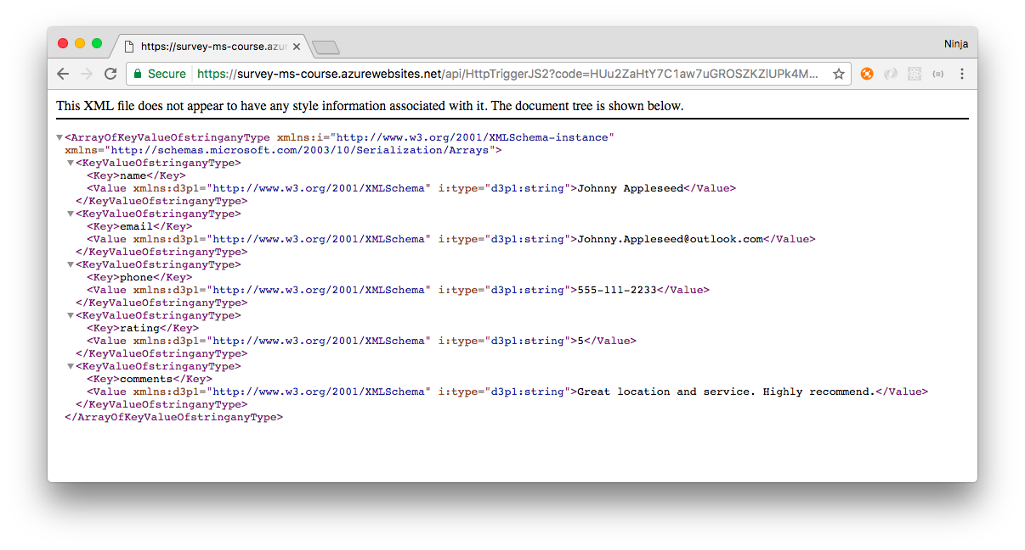
Survey Function Response
Notes:
Notes:
You can modify the response by changing res.body in context.done(null, res) in the code. Also, see the logs in the portal and check the payload/body/data.

Slide 35
Serverless Survey: Validate Data in the DB
Install Microsoft Azure Storage Explorer
Retrieve name and key
Validate sent data in the database
Notes:
Notes:
This step is optional. Download desktop Explorer app, connect to DB and validate the data is there.

Slide 36
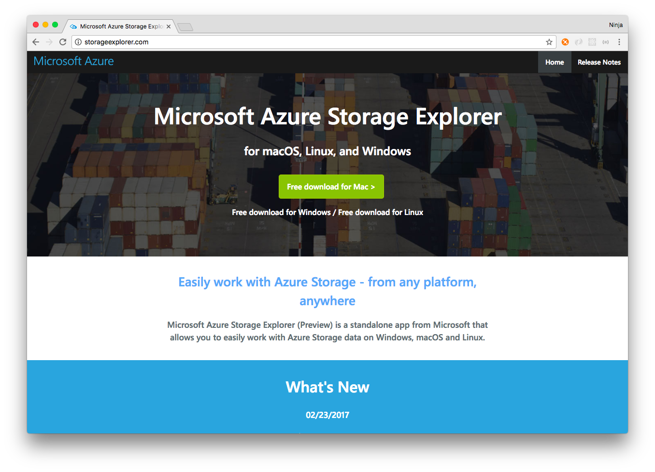
1 - Explorer
Notes:
Notes:
http://storageexplorer.com

Slide 37
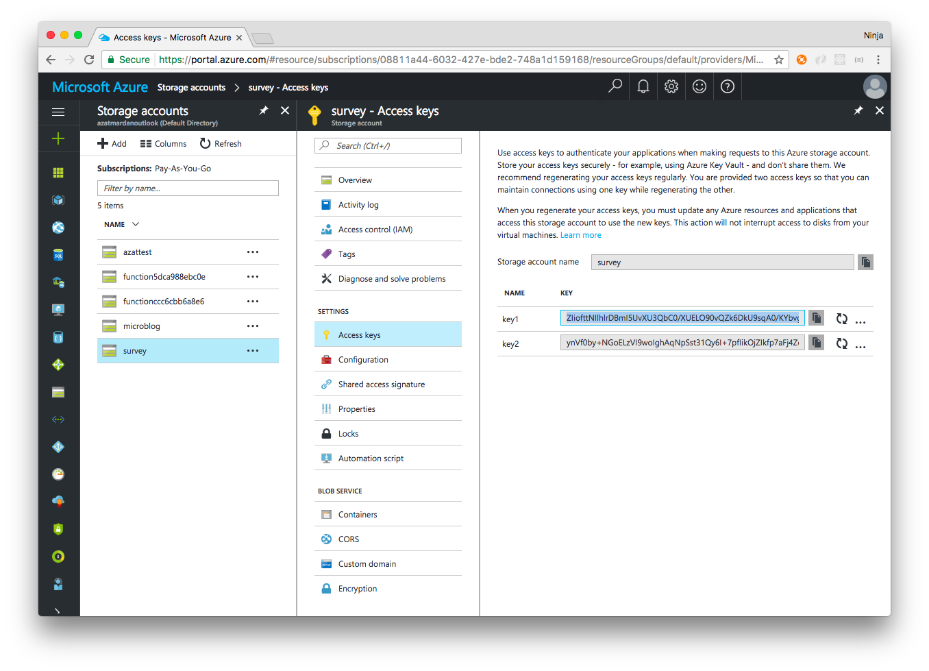
2 - Storage Name and Keys
Notes:
Notes:
Storage Keys are in the storage tab. To get there, select "Storage accounts" | storage by the name (that's the name) | Access keys, then copy key1 or key2.

Slide 38
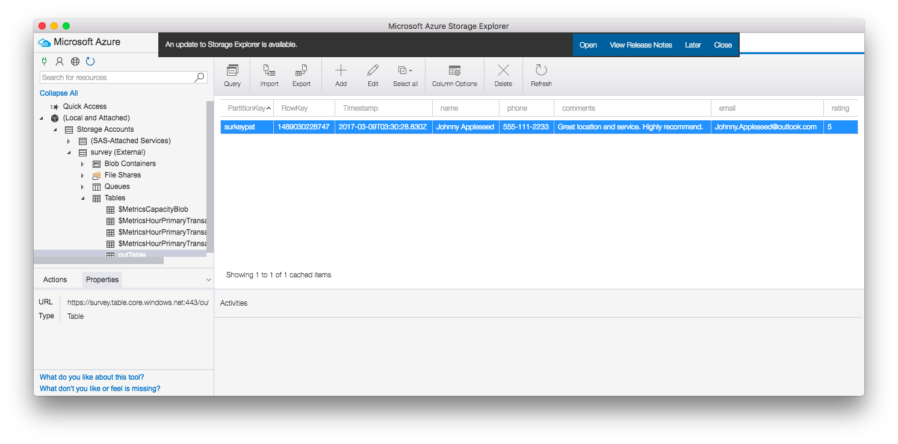
3 - Validate
Notes:
Notes:
Open explorer, paste name and key and select connect. Navigate to your appropriate storage and table and validate the data is the same as the data you sent via the web page (survey.html).
Congrats! You implemented cost effective and almost maintenance-free survey.
Before we finish, let's cover a few useful Azure features.

Slide 39
Useful Azure Features
Debug Console
Install npm packages
Files
Test
Logs
Azure CLI

Slide 40
Debug Console
https://{func-app-name}.scm.azurewebsites.net/DebugConsole
For example, https://survey-ms-course.scm.azurewebsites.net/DebugConsole
Functions Files:
\site\wwwroot Logs: LogFiles\Application\Functions\function
Install npm packages
cd site
cd wwwroot
cd HttpTriggerJS1
npm init -y npm i {package-name} -SE
Notes:
Notes:
This is the same Kudu tool which we used in previous lessons. Go to \site\wwwroot to see the folders where functions are stored. You install modules with npm i {name} in the terminal. There's debugger and logs (LogFiles\Application\Functions\function)

Slide 41
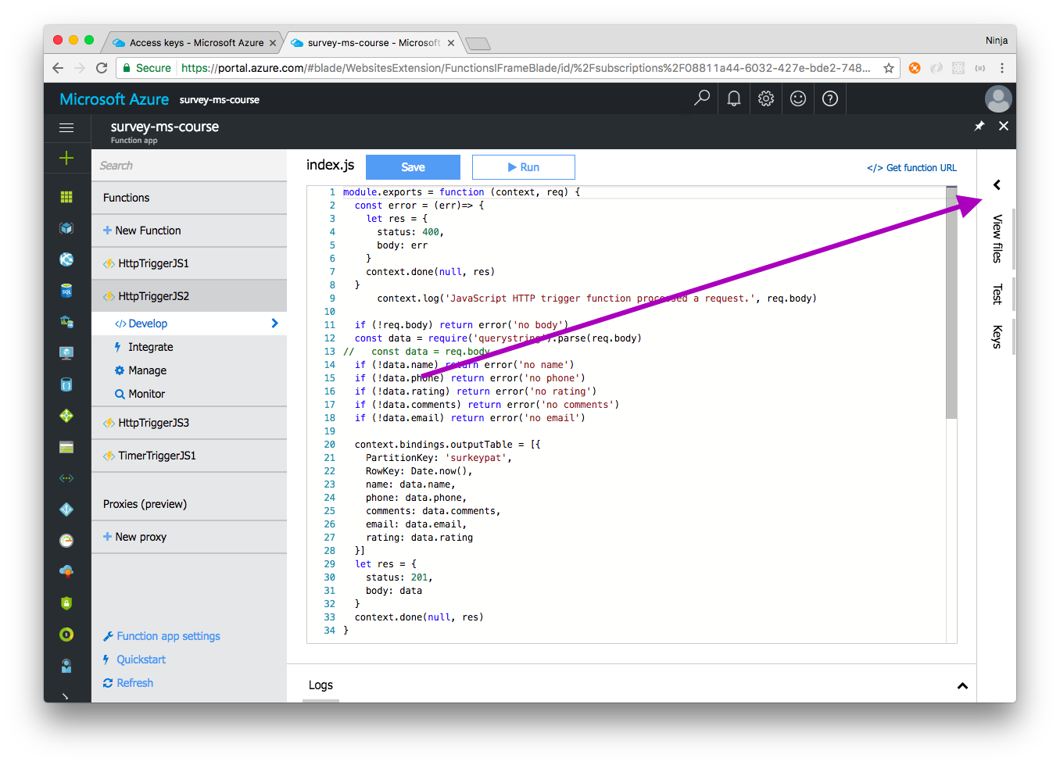
Files
You can view, add/upload, delete files which belong to a function
Notes:
Notes:
Refer to the prior slides for explanations on function.json. In brief, it has triggers and other meta info. You can upload HTML files like survey.html and serve them over HTTP. You can add packages and save their names and versions in package.json.

Slide 42
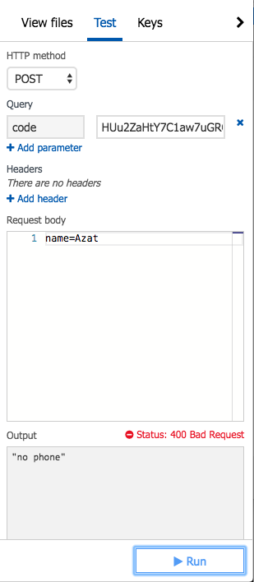
Test
Test tab is very useful.
Beware, survey.html sends urlencoded format and Test tab sends JSON.
The function code needs to be updated specifically for Test tab data
Notes:
Notes:
or use urlencoded in the Test tab, e.g., name=Bob&comments=lalala....

Slide 43
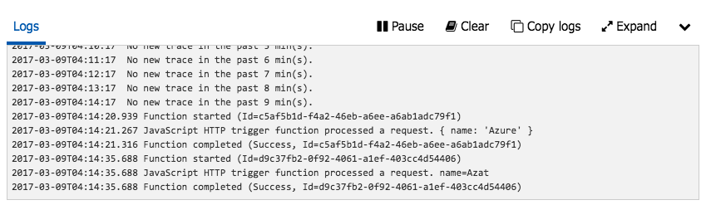
Logs
Notes:
Notes:
Select the bottom pane to see logs.

Slide 44
Azure CLI
The following links walk through the installation and basics of the Azure CLI:
https://docs.microsoft.com/en-us/azure/xplat-cli-install
https://github.com/Azure/azure-cli
Notes:
Notes:
Web interface (portal) is easy to start with, but hard to automate (how to create 100s of functions and delete them and then create again?).
CLI is great for automation and will allow you to treat infrastructure as code which in turn will allow you to version everything and reproduce from the code.

Slide 45
Summary
In this lesson, you have learned:
The basics of Serverless Computing, how and when to use it
The basics of Azure Functions
How to make a serverless survey using Azure Functions
Notes:
Notes:
The Module 2 Lesson 9 Lab should be competed at this time
https://github.com/MSFTImagine/computerscience/blob/master/Complimentary%20Course%20Content/Module2/Labs/Module%202%20Lesson%209%20Lab.docx

